Slide 1
Pembelajaran Mesin dan Pembelajaran Mendalam #4 Unsupervised Learning
Semester Gasal 2024/2025
Prodi Informatika
Universitas Atma Jaya Yogyakarta

Slide 2
Clustering
Machine learning tasks that group data without labels or targets which is clearly known as unsupervised learning.
Find a structure or pattern previously unknown in the data is the goal.
Clustering is one the most popular unsupervised learning method. Many industries, including analytics markets, consumer clustering, biological data analysis, image clustering, and many more, use this grouping technique extensively.

Slide 3
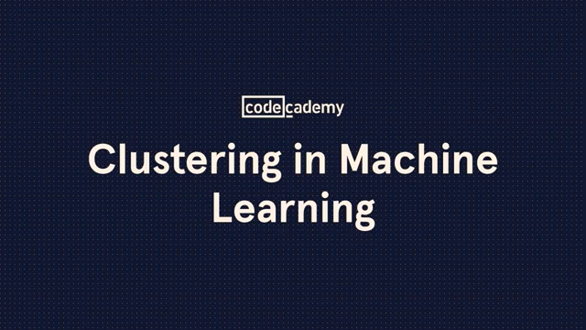
Clustering in Machine Learning
https://youtu.be/wk2ylI1qgU0?si=og0eqwJ4gsCPIsmd

Slide 4
Clustering
For example retail entrepreneurs can use clustering to group customers based on items purchased, total shopping costs paid, purchase amount, and so forth.
Entrepreneurs can understand different consumer groups and modify marketing strategies for each group.

Slide 5
Clustering methods
There are several methods clustering that is often used includes:
1. K-Means Clustering: creates clusters from data points by reducing the distance between each data point and the cluster center.
2. Hierarchical Clustering: separates data into clusters based on distance between data points, then create a dendrogram to illustrate relationships between clusters.
3. Density-based Clustering: divides data into several dependent clusters on the density of data points, then create clusters based on region with different densities.

Slide 6
Clustering advantages
The advantages of the clustering method are:
Does not require labeled data.
Can be used to see previously unknown patterns or structures on data.
Can be used to group data into groups which are similar to each other.

Slide 7
Clustering disadvantages
The disadvantages of the clustering method are:
Interpretation of clustering results is subjective and depends on the choice of method and parameter settings.
Selecting the optimal number of clusters is quite difficult and requires experience.
Has limitations in handling complex or high dimensional data.

Slide 8

K-means Clustering

Slide 9
K-Means Clustering
K-Means is one of the simplest and most widespread clustering algorithms used.
This algorithm works by trying to find the middle point (centroid) of a cluster which is a representation of a particular region of data.
This is done by placing each data point to the nearest center point.
Distance calculation using Euclidean distance.
Then set the cluster center point as the average of data points placed in the cluster.
The algorithm completes when the placement of data points towards the cluster center do not change anymore.

Slide 10
K-Means Clustering

Slide 11
K-Means Clustering: Pros and Cons
The advantage of K-Means clustering: easy to understand so you can serve as a basis for further analysis.
K-Means is easy to implement because runs relatively quickly. Additionally, k-Means can handle large datasets.
The disadvantages of k-Means: output that depends on the random_state value and the specified number of clusters by users.
K-Means cannot handle complex or non-distributed datasets equally.

Slide 12
K-Means Clustering Failure Case
If you know the "correct" number of clusters for a particular data set, k-means may not always be able to provide the appropriate ones
Each cluster is defined only by its center, which means that each cluster is a convex shape
K-means fails to identify nonspherical clusters

Slide 13

K-Means Algorithm Visualization
https://youtu.be/2lZZ_FzlIJY?si=ZD4PXI8ZcF9U1_D9

Slide 14
Agglomerative Clustering

Slide 15
Agglomerative Clustering
Agglomerative Clustering is a clustering method that first describes each existing data as a small cluster.
Gradually merge with each other based on the degree of similarity with other data.
This merger is also calculated based on the distance between clusters based on Euclidean distance or cosine similarity.
The algorithm is finished when it has formed a large cluster as we want.

Slide 16
Agglomerative Clustering

Slide 17
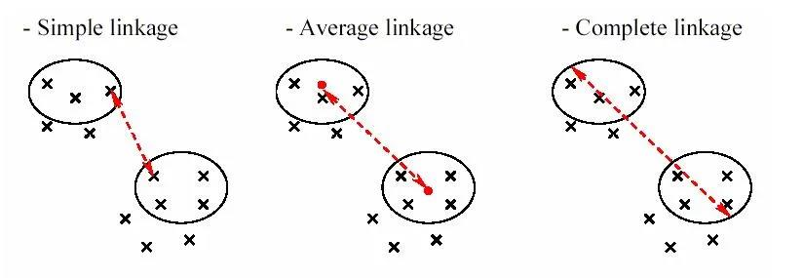
Agglomerative Clustering
Simple/Single Linkage: uses the shortest distance between all points data from two clusters.
Ward Linkage: makes the clusters formed have a relative size is the same as minimizing the variance of the combined clusters.
Average Linkage: combines the closest clusters based on the average the distance between the data points of the two clusters.
Complete Linkage: uses the maximum distance between second data points clusters.

Slide 18
Agglomerative Clustering
Agglomerative clustering uses a dendrogram to describe the clustering process that occurs.
Dendrograms not only describe when small clusters merge, but also the distance between clusters.
Advantages of agglomerative algorithms clustering: being able to group data with complex and irregular shapes and being able to produce stable clusters.
The disadvantage: the computing time is quite long for large data.

Slide 19

Hierarchical Cluster Analysis [Simply explained]
https://youtu.be/8QCBl-xdeZI?si=ZWipLT2kgKuHx4uO

Slide 20
DBSCAN

Slide 21
DBSCAN
DBSCAN (Density Based Spatial Clustering of Applications with Noise) is clustering algorithm that allows us to generate clusters without determining the number of clusters first.
DBSCAN works by selecting data that is not yet included in a cluster and looking for neighboring data points that are less than or equal to the epsilon parameter value.
If the number of neighboring data points found is greater or equal to the specified minimum samples parameter value, then the data is considered a core point and forms a cluster.
Next, DBSCAN will look for neighboring data points from the core point and add them to the same cluster.
This process will continue until no more new neighbors are found. Data that does not belong to any cluster is referred to as noise.

Slide 22
DBSCAN
There are two main parameters of DBSCAN, namely min_samples and epsilon.
Min_samples states the amount of data or samples that will be calculated as core points.
The more minimum samples, the fewer core points and the more noise. Because many data points are needed as core samples and their proximity must be calculated using epsilon.
Epsilon determines how close a data point is to another. Epsilon with a small value means no data points are considered core samples and all points are considered noise.
Epsilon with a large value makes all data points a single cluster.

Slide 23
DBSCAN

Slide 24
DBSCAN
The advantage of DBSCAN is that it is able to handle data with uneven density and is able to determine the number of clusters automatically.
DBSCAN is also not susceptible to being influenced by outliers.
The disadvantage of DBSCAN is that it requires determining the correct epsilon and minimum samples parameters to produce the optimal number of clusters.
DBSCAN is also not effective for high-dimensional data or complex data.

Slide 25
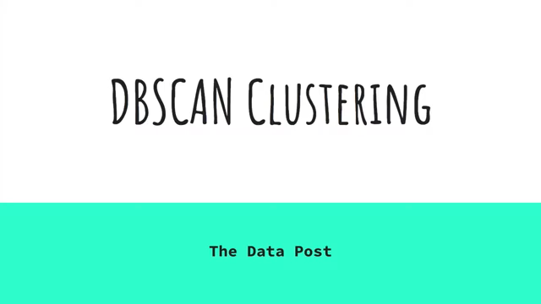
DBSCAN Explanation and Visualization
https://youtu.be/_A9Tq6mGtLI?si=wxCPVye0MU5uCQyR

Slide 26
Elbow Method and Silhouette Score
Elbow Method is a method for determining the number of clusters optimal (K) using the WCSS (Within-Cluster Sum of Square) metric.
WCSS is the sum of the powers of the distance between each data point and the inner centroid a cluster.
Because it takes centroids into account, k-Means is used as basic algorithm.
When we plot the WCSS value against the K value, the line formed to look like an elbow.

Slide 27
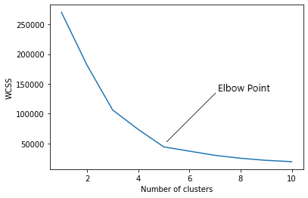
Elbow Method and Silhouette Score
As the number of clusters increases, the WCSS value will drop. The WCSS value is greatest when K = 1.
The graph changes quickly at one point that makes a significant angled shape. The K value indicates the point is the optimal number of clusters.

Slide 28

The Elbow Method Explained in Less than 5 minutes
https://youtu.be/ht7geyMAFfA?si=gkYU2ObyUO9Rt_12

Slide 29
Elbow Method and Silhouette Score
However, when there is no clear Elbow point, Silhouette Score can be used to support determining the optimal number of clusters.
Silhouette Score is a value that shows how precisely a point is placed in a cluster.
The value of the Silhouette Score has a range of -1 to 1. The interpretation is as follows:
-1: data point is assigned to the wrong cluster
0: data points are in clusters that overlap (overlap)
1: data points are precisely placed in a cluster and clustered appropriately easy to distinguish

Slide 30
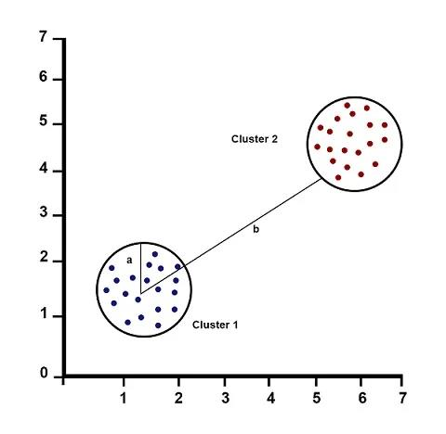
Elbow Method and Silhouette Score
Silhouette Score equation is:
𝑆𝑖𝑙ℎ𝑜𝑢𝑒𝑡𝑡𝑒 𝑆𝑐𝑜𝑟𝑒 = (𝑏 − 𝑎)/max(𝑎, 𝑏)
where a is the average distance between each data point in a cluster (intra), and b is the average distance between all clusters (inter)
How to determine the optimal number of clusters based on the Elbow Method and Silhouette Score? The following conditions must be checked:
For a certain K value, all clusters must have a Silhouette Score value of more than average Silhouette Score of the entire dataset.
There should be no significant size differences between clusters.

Slide 31

Silhouette Score, Inliers, and Outliers
https://youtu.be/a2Kg2_l3L8M?si=n2x0UJ8iihA8Vw8r

